Slide 1

INTRODUCTION TO HUMAN-COMPUTER INTERACTION
SEMESTER ASSIGNMENT

Slide 2
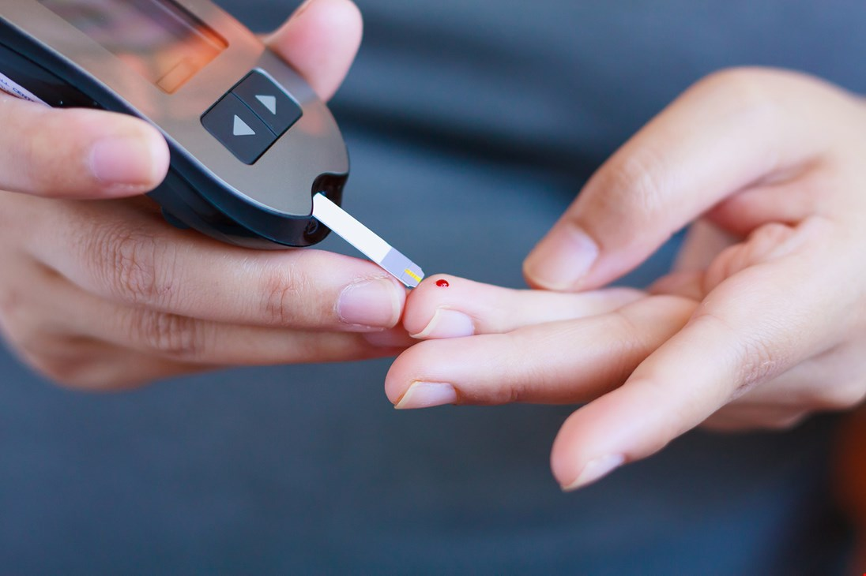
PROBLEM SPACE
Today, people with diabetes need to stick your fingers every day, some of them several times a day to check the level of blood sugar
Foto: diabetesforbudet

Slide 3
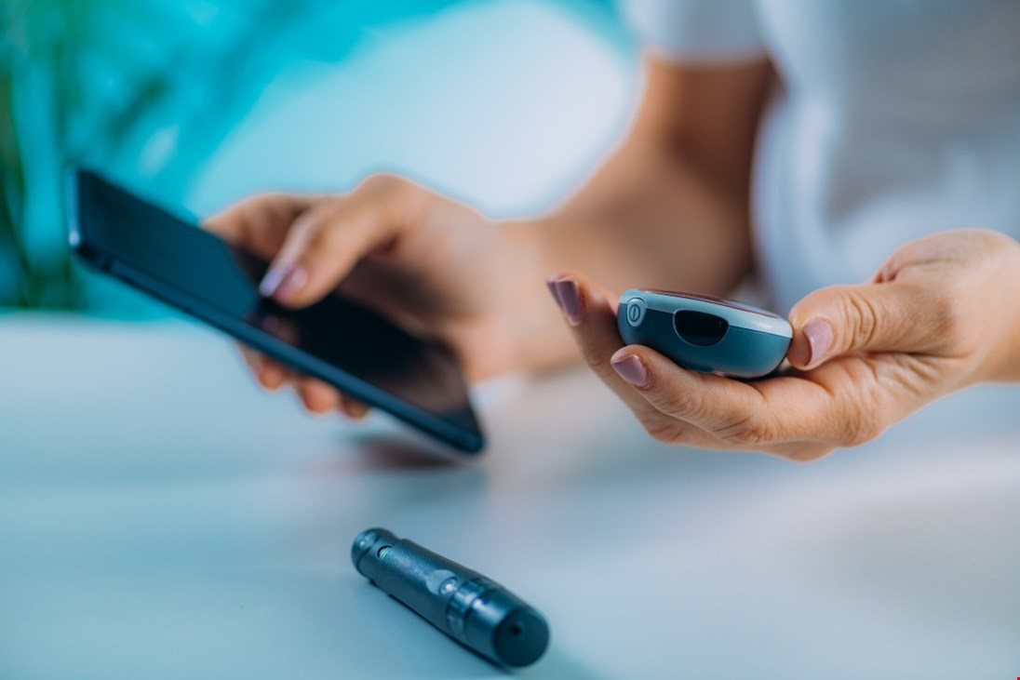
TARGET GROUP
In our case, target are people with diabetes
Foto: diabetesforbudet

Slide 4

OUR IDEA
Present an equipment that allows checking the glucose level that is not invasive. That’s means, people will no longer need to stick their finger out.
Foto: internet

Slide 5
SIMILAR PRODUCTS
BioMKR

Slide 6
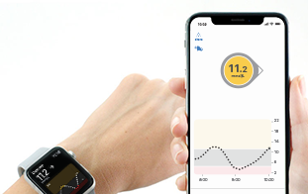
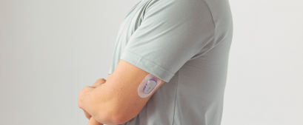
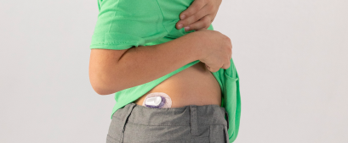
SIMILAR PRODUCTS
Dexcom G6 CGM-systemet
Foto: dexcom.com

Slide 7
SIMILAR PRODUCTS
Eversense:

Slide 8
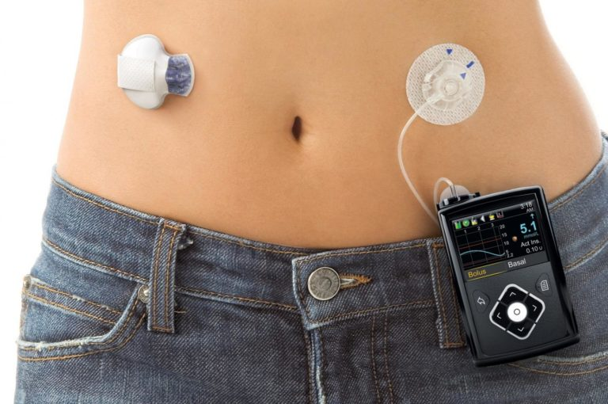
SIMILAR PRODUCTS
Closed loop systems

Slide 9
LIST OF REFERENCES
Klokke for ikke‐blodig måling av blodsukker
https://www.ntnu.no/documents/10355/1262992082/Prediktor+-+Kybernetisk+fagdag+071114.pdf/182ddd08-8c43-4196-9fab-77ff2ee2be1c?fbclid=IwAR3wBctUh1xR7e8L_9dTwjb1kzYbX8TcK1C5W6c8f9Sto18P59uJwtcEMaE
Klokke kan oppdage diabetes og høyt blodtrykk
https://komputer.no/it-og-samfunn/smartklokken-kan-oppdage-diabetes-og-hoyt-blodtrykk
smarte diabetesapper
https://levmeddiabetes.no/2014/02/diabetesapper/
Dexcom G6 Continuous Glucose Monitoring (CGM) System
https://www.dexcom.com/nb-NO/no-dexcom-g6-cgm-system
Målinger av blodsukker
https://www.diabetes.no/globalassets/helsepersonell/diabetesforum/nasjonalt-diabetesforum-2017/apotekansatte/tilla-landbakk.pdf
BioMKR for kontinuerlig ikke invasiv måling av blodsukker hos personer med diabetes.
https://helseforskning.etikkom.no/Content/975678/GlucoPred%202%20studien.pdf
Tim Cooks blodsukker gir fart på Apple Watch-rykter
https://e24.no/teknologi/i/kJvJM9/tim-cooks-blodsukker-gir-fart-paa-apple-watch-rykter
About Closed Loop System (CLS):
https://loopkit.github.io/loopdocs/
https://medium.com/@loudnate/the-history-of-loop-and-loopkit-59b3caf13805
https://levmeddiabetes.no/2019/06/closed-loop-system-overgi-diabetesen-din-til-teknologi/
https://www.thediabetescouncil.com/closed-loop-systems-future-treatment-for-diabetes/
den perfekte diabetesapp?
https://levmeddiabetes.no/2019/04/kunne-dette-blitt-den-perfekte-diabetesapp/

Slide 10
THE END
Thank you for your attention

